Slide 1
Gut Passage Meta-Analysis
Alex karnish
EEb590 Final Presentation

Slide 2
Introduction
In order to disperse seeds and initiate germination, plants produce fleshy fruits that animals (frugivores) ingest. (Eriksson 2014)
Different types of animals have different effects on seeds during ingestion; some may increase the probability of germination, while others completely destroy the seed. (Traveset 1998)
Whether or not a seed is viable after an animal eats it can determine the dispersal and survival of a species. (Panetta 1997)
Over the past sixty years, scientists have done feeding trials with a variety of fruits and frugivores in order to gauge fruit ingestion’s effect on seed germination. (Krefting 1949)
Eriksson, Ove. 2014. "Evolution of Angiosperm Seed Disperser Mutualisms: The Timing of Origins and Their Consequences for Coevolutionary Interactions between
Angiosperms and Frugivores." Biol Rev Biological Reviews 91.1: 168-86. Web.
Krefting, Laurits W., and Eugene I. Roe. 1949. "The Role of Some Birds and Mammals in Seed Germination." Ecological Monographs 19.3: 269. Web.
Panetta, F. D., and J. Mckee. 1997. "Recruitment of the Invasive Ornamental, Schinus Terebinthifolius, Is Dependent upon Frugivores." Austral Ecology Austral Ecol 22.4:
432-38. Web.
Traveset, A. 1998. "Effect of Seed Passage through Vertebrate Frugivores' Guts on Germination: A Review." Perspectives in Plant Ecology, Evolution and Systematics 1.2:
151-90. Web.

Slide 3
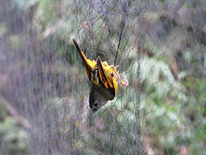
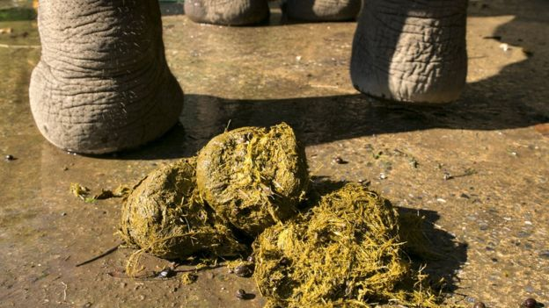
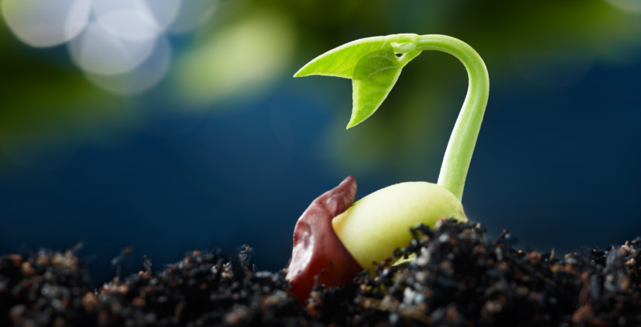
Types of Experiments
All studies in this meta-analysis have two main components:
A feeding trial or collection of ingested seeds from the field
A germination trial with gut passed seeds and control seeds
Examples of control: intact fruit, manually extracted seeds, manually scarified seeds.

Slide 4
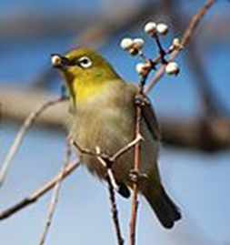
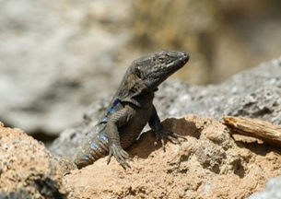
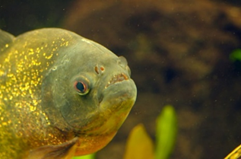
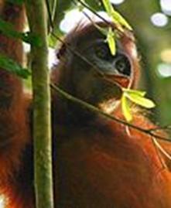
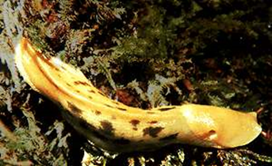
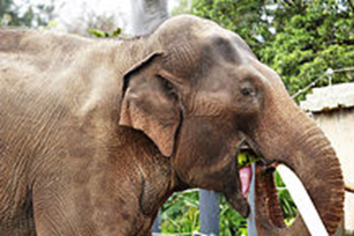
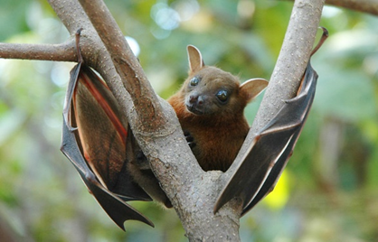
Methods
We employed several approaches to finding papers:
Initially, we searched through all papers cited in Traveset’s 1998 paper, “Effect of Seed Passage through Vertebrate Frugivores' Guts on Germination: A Review”.
Next, we searched all papers that cited Traveset’s 1998 paper.
Finally, we conducted a systematic search on Web of Science using the phrases “fruit”, “germination”, “ingestion”, and “frugivores”.
Then for each paper recorded
Genus and species of each plant and fruigivore, type of frugivore, location of study
Individual fruit/frugivore interactions (~1400) with the proportion germinating from the gut passed seeds and the control.

Slide 5
Analysis
Metafor
Package in R
Specifically for meta-analyses
Practice datasets in R
Finding heterogeneity
“variation in study outcomes between studies”

Slide 6
Analysis
Based on grid and vectors
escalc(measure="RR", ai=gut.passed.prop.germ, bi=no.germ, ci=comparison.prop.germ, di=no.germ.1, data=practice3)
Finds yi (effect size) and vi(sampling variance)
Find heterogeneity with a Random Effects Model
Germinated
yes
no
Gut passed
ai
bi
control
ci
di

Slide 7
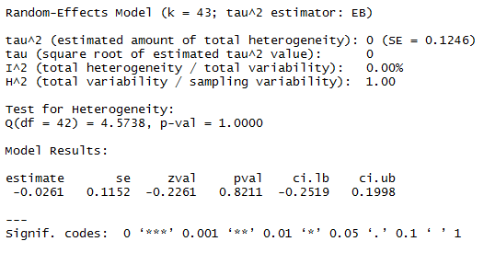
Model
rma(yi, vi, data=practice4, method="EB")

Slide 8
Discussion/Questions
No heterogeneity
Small data set
Did I do this right?
Does anyone here know how to use metaphor?

